Slide 1
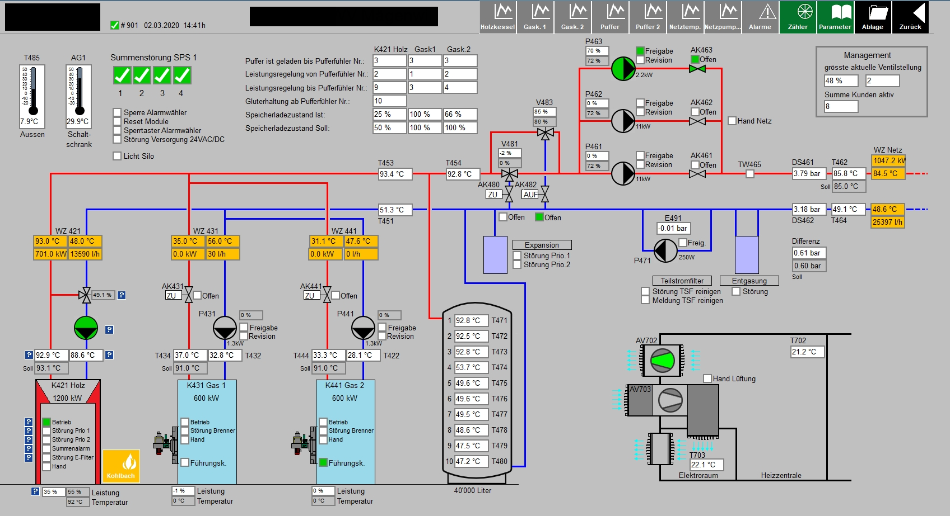
01 Optimization of District Heating
1901_protWZ.csv
2901_protWZ.csv
3901_protWZ.csv
4901_protWZ.csv

Slide 2
1901_protWZ.csv
2901_protWZ.csv
3901_protWZ.csv
4901_protWZ.csv
Biomass
Gas peak
Gas peak
Storage

Slide 3

Challenge
Decrease gas peak boiler runtime due to better storage operation
3. better storage operation 2. improved storage control 1. heat demand forecast
Biomass
Gas peak
Gas peak
Storage

Slide 4

8
350 kW (07/2018)
8_prot.csv
9
60 kW (10/2018)
9_prot.csv
850 kW
1006_protWZ.csv
6_protSPS.csv¹
6
30 kW (01/2018)
7_prot.csv
7
1
650 kW
1_prot.csv
2
90 kW
2_prot.csv
3
160 kW
3_prot.csv
4
60 kW
4_prot.csv
Legend:
X
<nominal power> (<date of connection>)
<data file>
5
100 kW
5_prot.csv

Slide 5
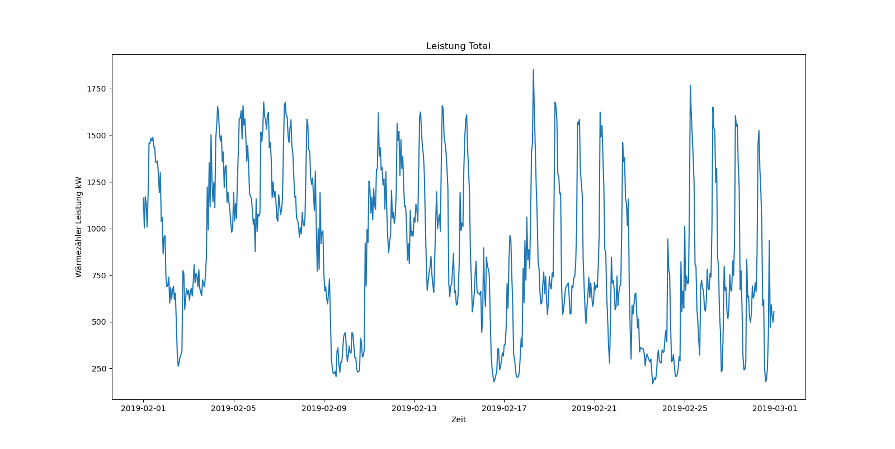
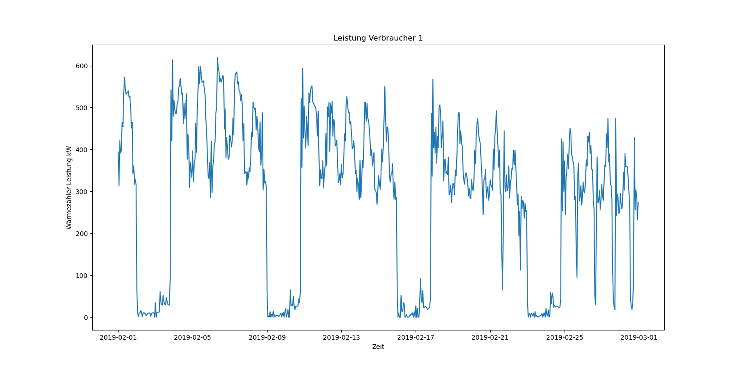
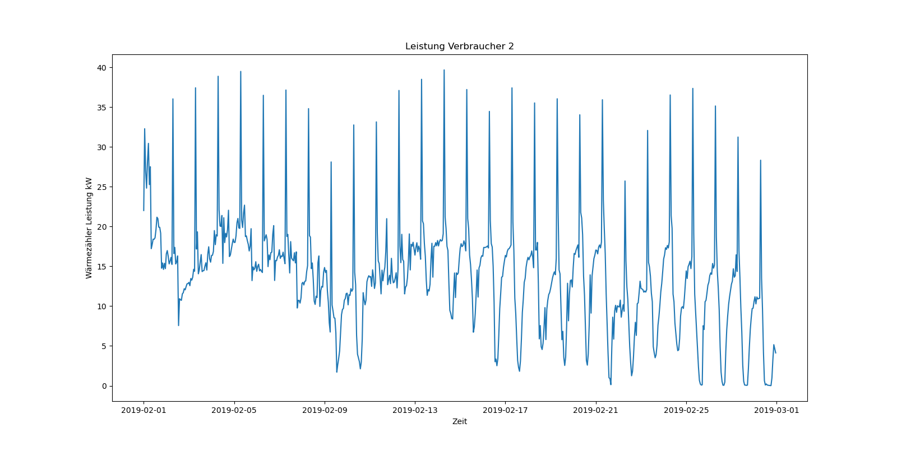
8
9
6
7
1
2
3
4
5

Slide 6
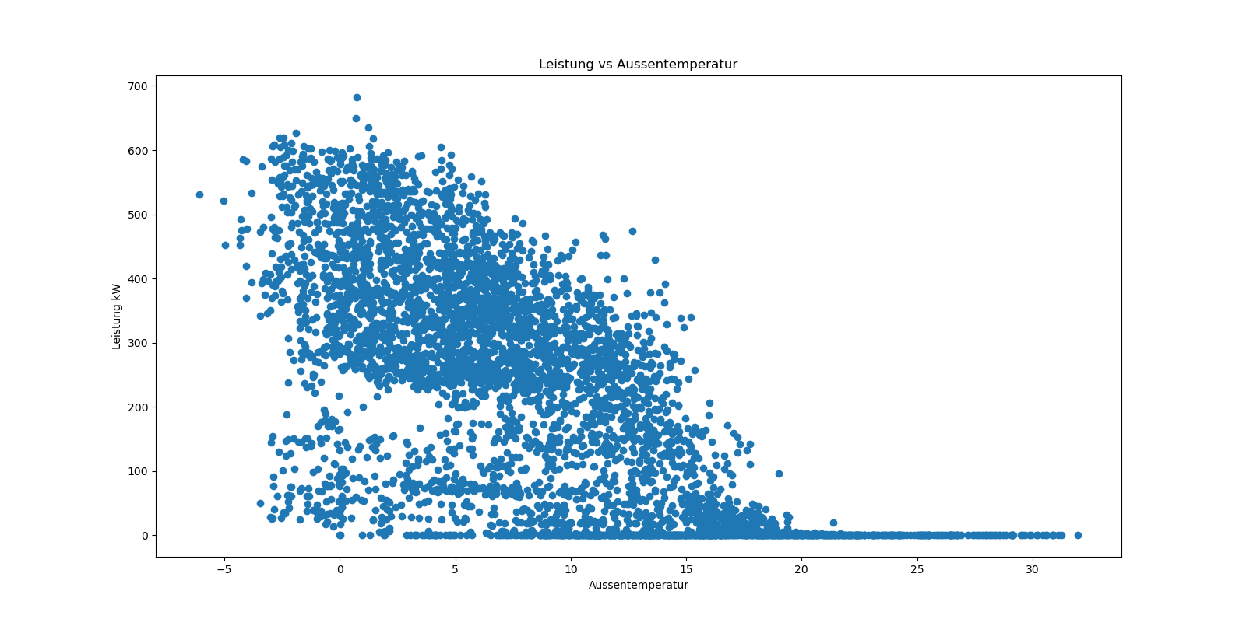
Correlation heat demand vs. ambient temperature

Slide 7
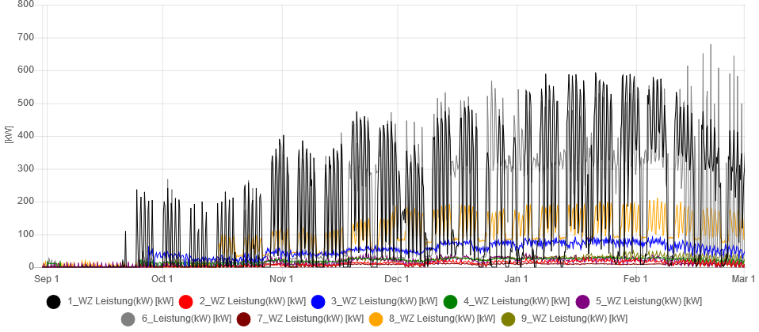
Main consumers heat demand
3 consumers out of 9 dominate the heat required

Slide 8
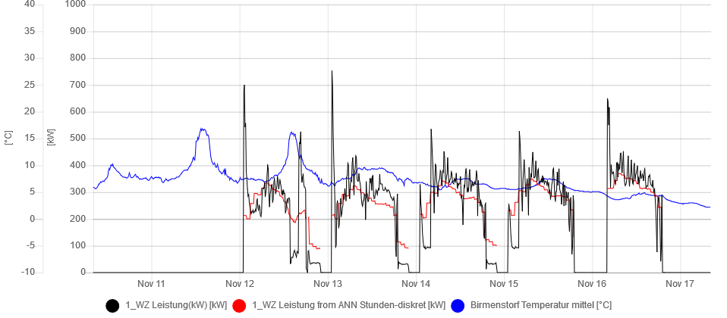
Forecast vs. measured heat required | biggest consumer

Slide 9
Further proceeding
Finalize forecast algorithm (main consumers, load profiles, parameters)
Develop concept for new control settings
Set point biomass boiler + set point storage vessel
New control settings implementation
Simulation with existing data: do new settings make sense/savings?
Run new settings manually
Run new settings auto
Transfer to other CH district heating systems

Slide 10
01 Optimization of District Heating
Team
Andy Gubser
Emilie Boillat (remote)
Martin Horeni
Marvin Grass
Toni Wietlisbach (AEW, owner)
Wolfram Willuhn

